Slide 1
Sentiment Analysis of Tweets on US based Airlines

Slide 2
The problem
Problem Statement
Process
Goal
Analyzing the US based airline's tweets by using sentiment analysis on the tweets of the airlines
Classify the sentiments as positive, neutral and negative for each airlines.
Tokenizing the tweets as unigrams/ bigrams / trigrams and finding their significance on the sentiments.
Provide insights to airlines who want to predict how tokenized phrases may influence sentiment of the customer tweets.

Slide 3

Overview of Data
Data is obtained from the airline sentiment dataset in Kaggle .
Dataset contained 14640 rows and 15 columns.
There will be some derived columns and existing 15 columns are as follows

Slide 4
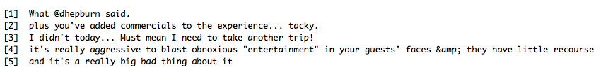
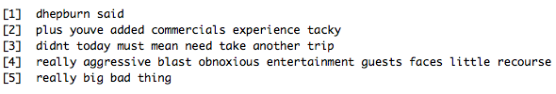
Data Wrangling
Replace twitter handle with blank
Build and cleaning the corpus
Remove Punctuations, URL’s and anything but English
Convert the corpus to lowercase
Remove Extra White Space
Converting corpus to data frame
3. Stemming for corpus and removal of sparse terms from TDM were skipped in order to consider all words from the tweets.
Before
After

Slide 5
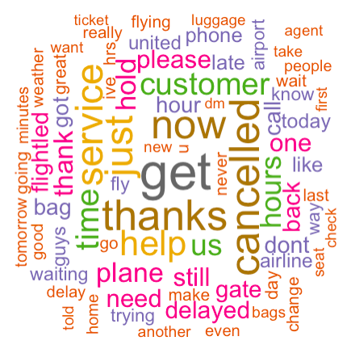
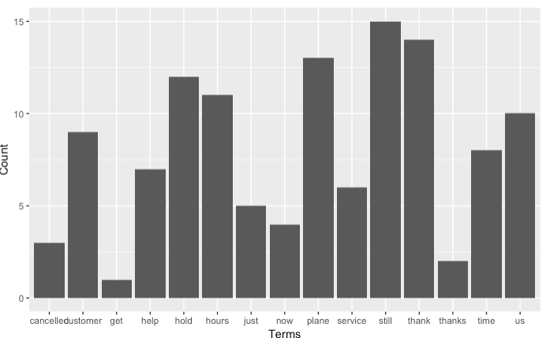
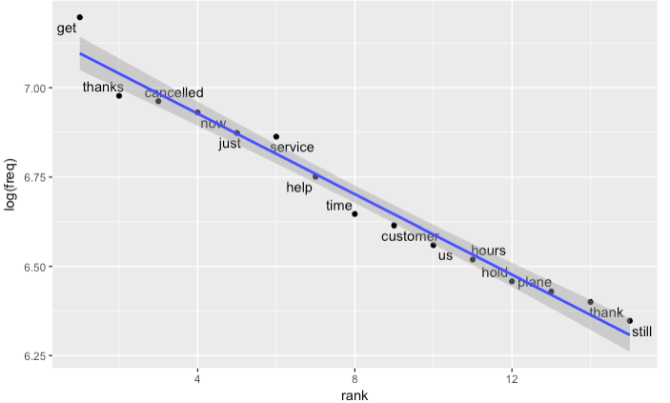
Exploratory Data Analysis
Data frames of unigram, bigrams and trigrams are created before plotting word clouds and bar plots for visualization and analysis.
Word Cloud
Top Frequent terms
Top Frequent terms on log scale

Slide 6
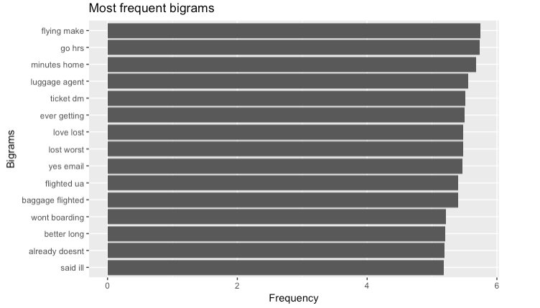
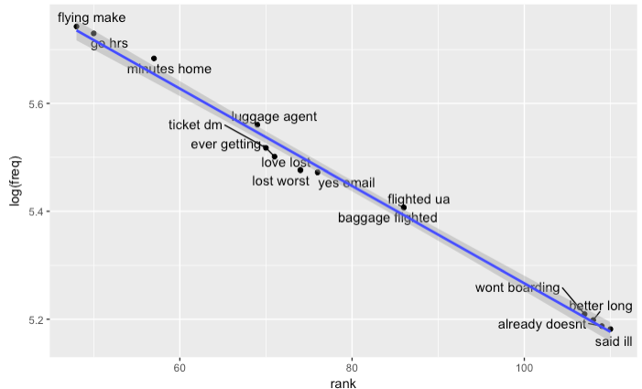
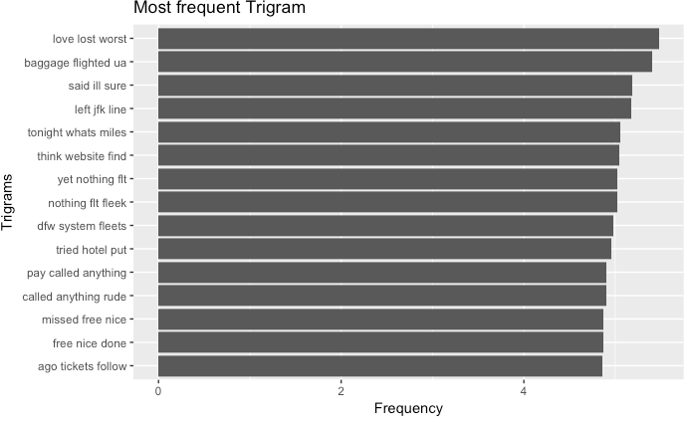
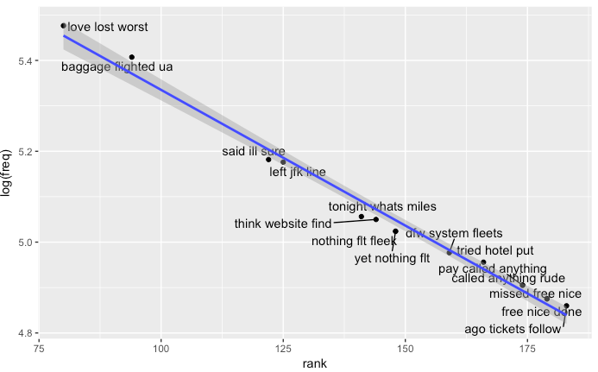
Exploratory Data Analysis (Contd)
Top 10 Frequent bigrams
Top Frequent bigrams on log scale
Top 10 Frequent trigrams
Top Frequent trigrams on log scale

Slide 7
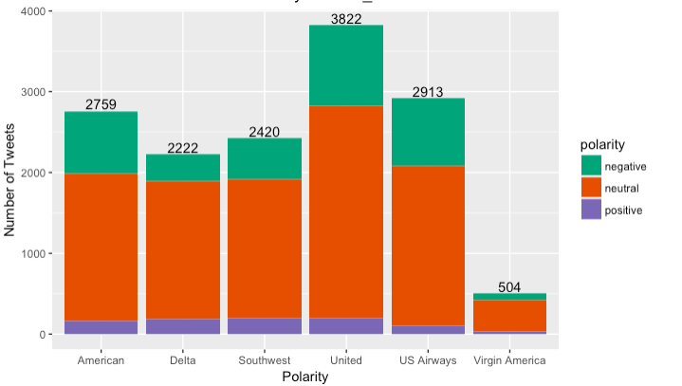
Sentiment Analysis
Sentiment Analysis is performed on the entire dataset to identify the positive, negative and neutral sentiment of the tweets.
Most of the tweets are neutral. The negative tweets are more than the positive tweets.
This helps in finding significance of unigrams, bigrams and trigrams on sentiments

Slide 8
Preparing for the model
1. DTM was created from Vcorpus and data frame were created for unigram, bigram and trigram
2. Unigram , Bigrams and Trigrams were joined together along with sentiments data frame for preparing the dataset

Slide 9
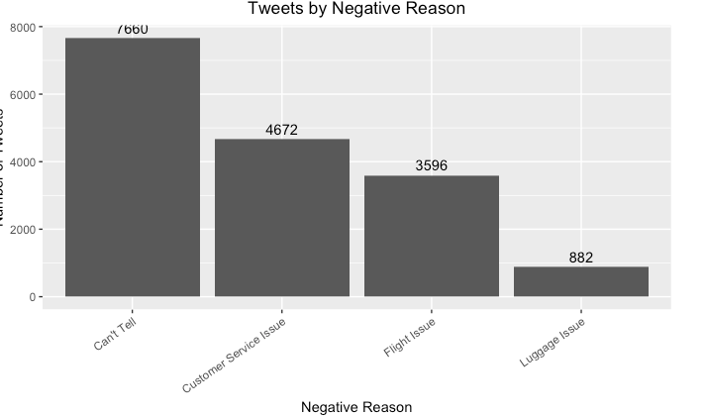
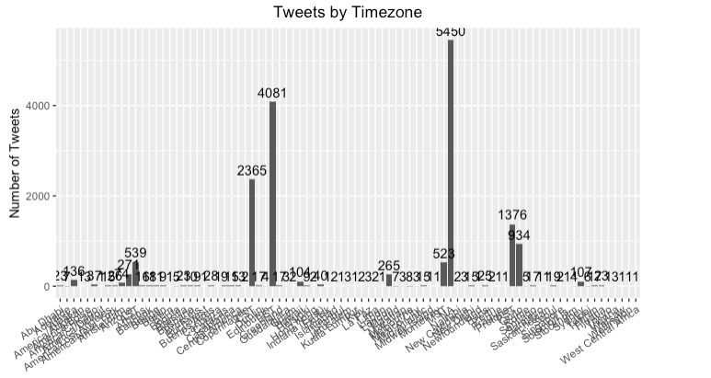
Feature Engineering
Tweets by negative reasons are mapped into 4 categories : customer service issues, flight issues, luggage issues and cant tell.
2. Tweets by location are mapped into various categories.

Slide 10
Methodology Used
1. Dataset is split using createDataPartition from the caret package. The dataset is split into 70:30 ratio.
2.Mapping the values for training and training dataset for Positive, Neutral and Negative variables for unigrams, bigrams and trigrams
3. Balancing the training dataset using SMOTE classification algorithm

Slide 11
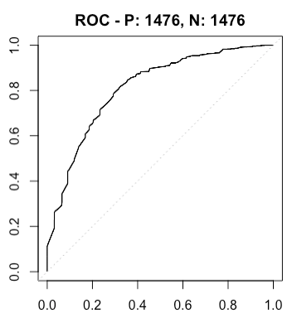
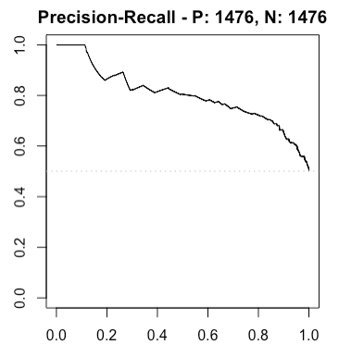
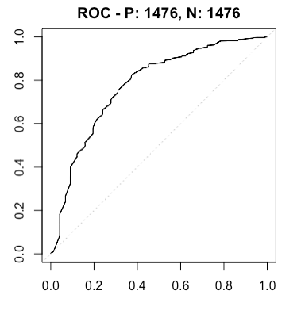
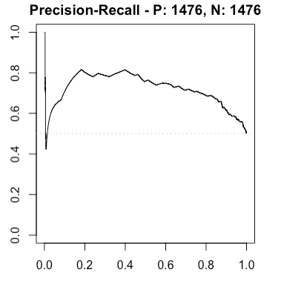
Methodology Used
4. Performed Cross Validation using Logistics Regression and Naive Bayes for tweet reason and sentiment frequency.
5. Performed Cross Validation Naive Bayes for entire training dataset and retained only those models which showed variance.
6. Displaying the ROC curves for models having ROC values more than 0.5
Bigram Positive ROC : 0.81
Bigram Positive PR : 0.80
Trigram Positive ROC : 0.77
Trigram Positive ROC : 0.72

Slide 12
Methodology Used
4. Performed Cross Validation using Logistics Regression and Naive Bayes for tweet reason and sentiment frequency.
5. Performed Cross Validation Naive Bayes for entire training dataset and retained only those models which showed variance.
6. Displaying the ROC curves for training models having ROC values more than 0.5
Bigram Positive ROC : 0.81
Bigram Positive PR : 0.80
Trigram Positive ROC : 0.77
Trigram Positive ROC : 0.72

Slide 13
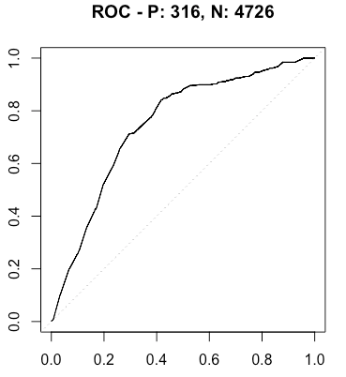
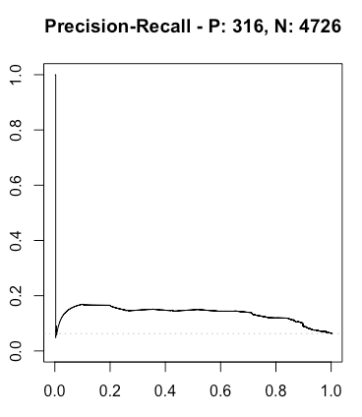
Methodology Used
7. Performed Cross Validation Naive Bayes for entire test dataset and retained only those models which showed variance.
8. Displaying the ROC curves for testing models having ROC values more than 0.5
Bigram Positive ROC : 0.74
Bigram Positive PR : 0.12

Slide 14
Results
The model with the best performance was a bigram positive and trigram positive model from the entire training dataset.
The bigram positive model performed the best with entire testing dataset
It is possible to train a model to determine the sentiment of airline tweets and determine if the customers are having negative or positive experience based on their tweets.
Bigram positive terms have more significance in determining the sentiment.

